Slide 1
Dynamic Programming (download slides and .py files from Stellar to follow along)
John Guttag
MIT Department of Electrical Engineering and Computer Science

Slide 2
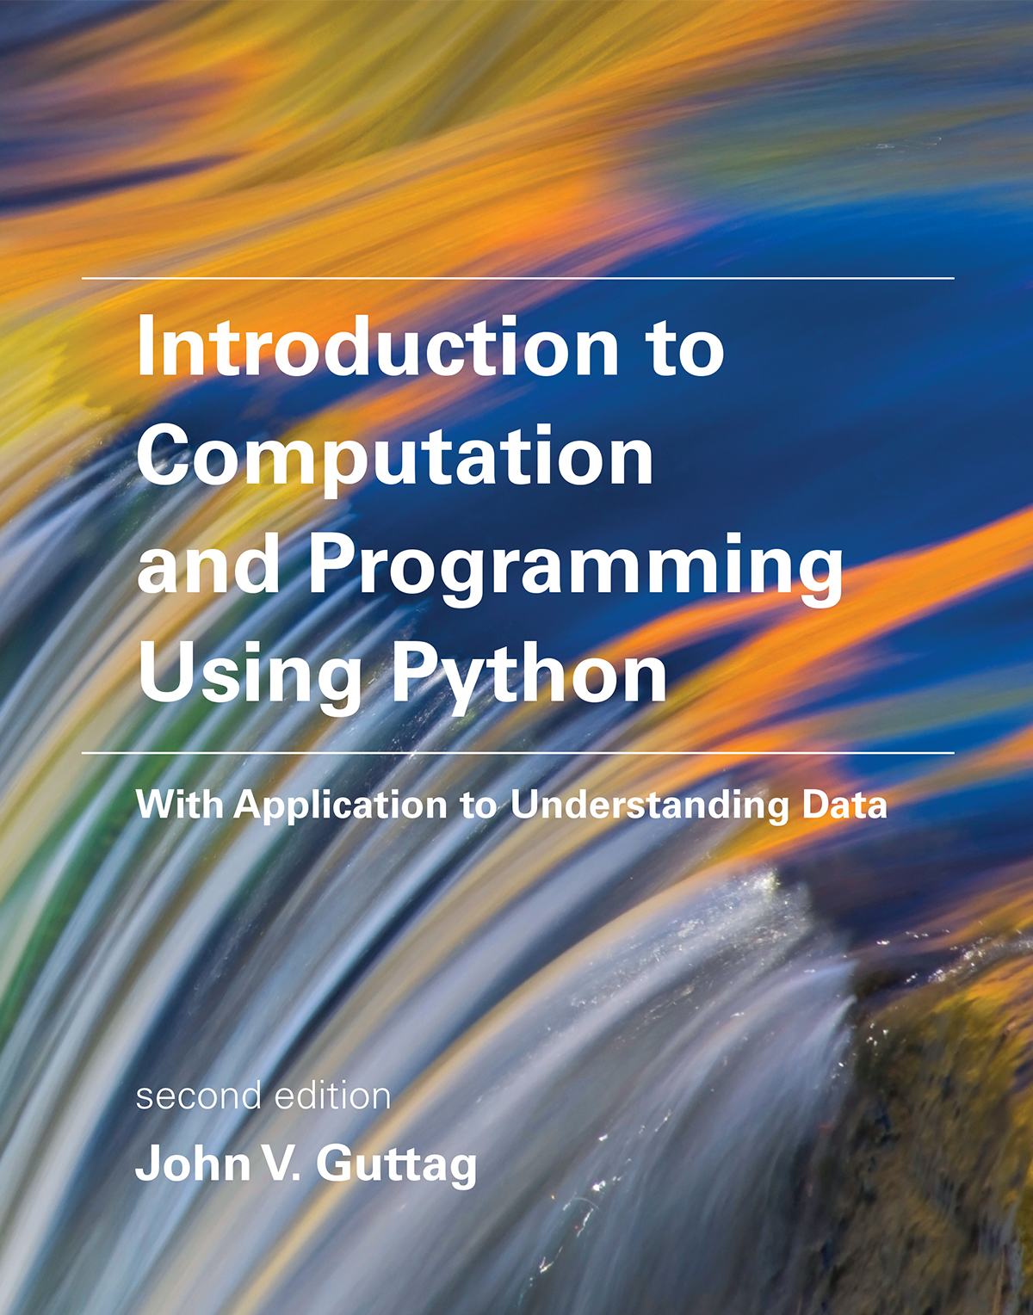
Relevant Reading
Chapter 13
Section 5.3.2 (List comprehension)
Calendar note:
No class or office hours the Wednesday before Thanksgiving
PS 4 is due that day
Break will count as 1 late day
Corrections posted on course web sites

Slide 3
Search Tree Implementation, revisited
The tree is built top down starting with the root
The first element is selected from the still to be considered items
If there is room for that item in the knapsack, a node is constructed that reflects the consequence of choosing to take that item. By convention, we draw that as the left child
We also explore the consequences of not taking that item. This is the right child
The process is then applied recursively to non-leaf children
Once tree generated, chose a node with the highest value that meets constraints

Slide 4
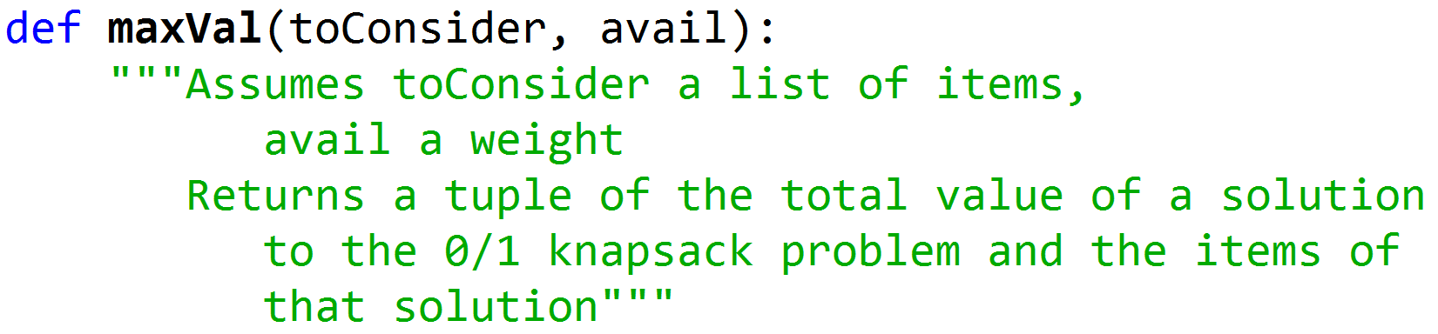
Header for Decision Tree Implementation
toConsider. Those items that nodes higher up in the tree (corresponding to earlier calls in the recursive call stack) have not yet considered
avail. The amount of space still available

Slide 5
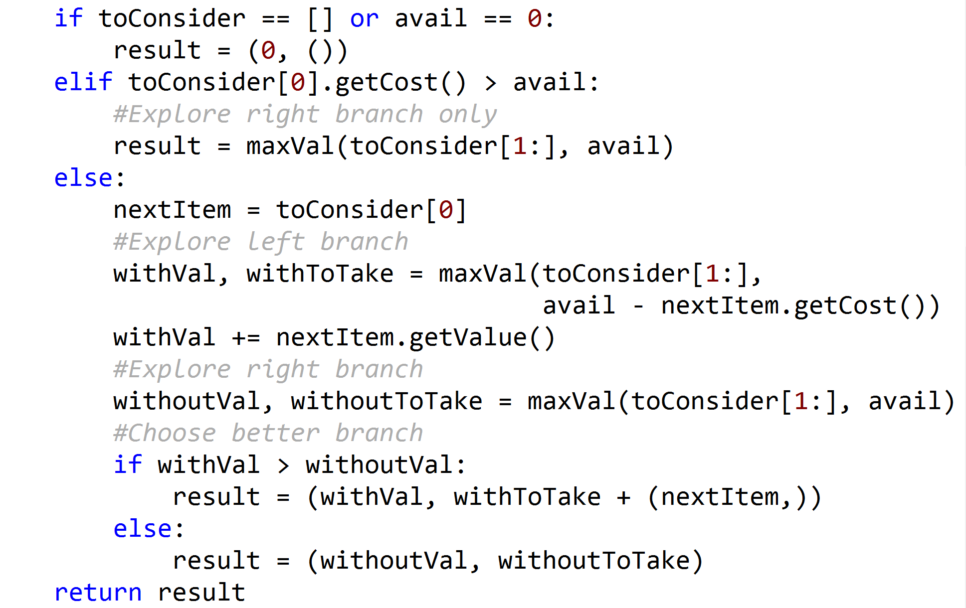
Body of maxVal
Don’t explore paths that exceed constraint
Local variable
result records
best solution so far
Does not actually build search tree
Local variable result records best solution found so far
Notes:
Does not actually build search tree
Local variable result records best solution found so far

Slide 6
Some Things to Note
Don’t actually build a search tree
Generate one path through the tree at a time
Path encoded in recursive call stack
Keep track of best path so far
In local variable result

Slide 7
Try on Example from Lecture 1
With calorie budget of 750 calories, chose an optimal set of foods from the menu
Food | wine | beer | pizza | burger | fries | coke | apple | donut
Value | 89 | 90 | 30 | 50 | 90 | 79 | 90 | 10
calories | 123 | 154 | 258 | 354 | 365 | 150 | 95 | 195
Note: I’ve changed testGreedy and testGreedys to make it easier to compare results to maxVal

Slide 8
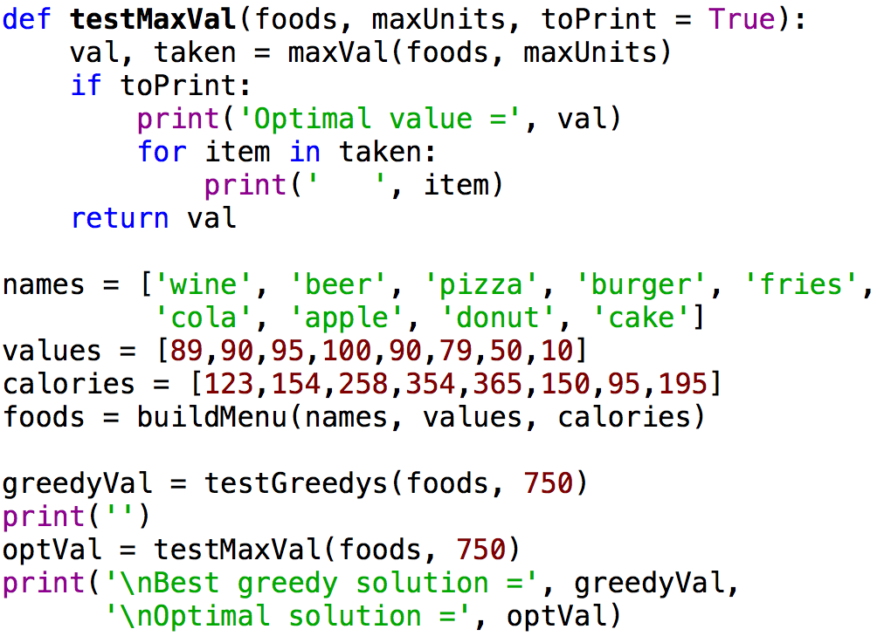
Testing maxVal
Run it

Slide 9
Search Tree Worked Great
Gave us a better answer than any of the greedies
Finished quickly
But 2⁸ is not a large number
We should look at what happens when we have a more extensive menu to choose from

Slide 10
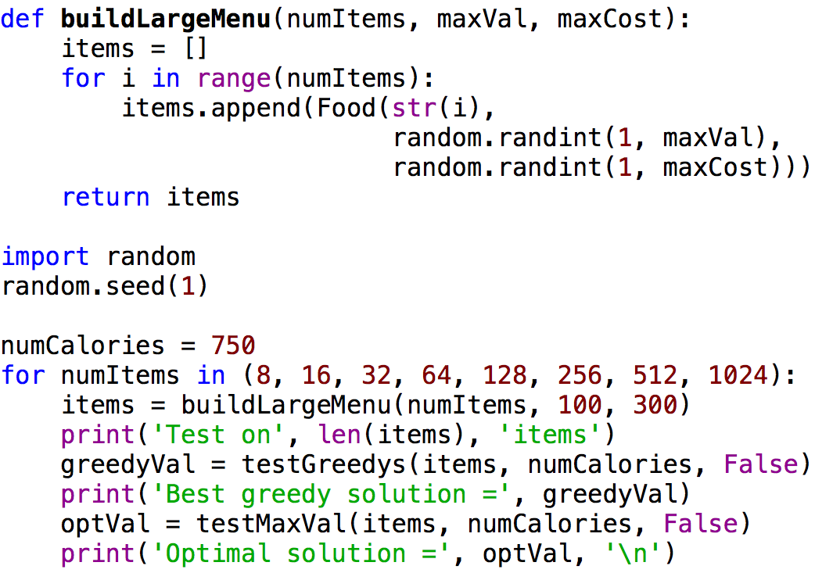
Code to Try Larger Examples

Slide 11
Random Test Data
When you want to see how things scale, you need large test sets
You want to generate them, not type them
Generating them randomly
Helps to avoid bias
Can generate different test data each run
Both good and bad
Used random.seed to ensure same result each time
Run it

Slide 12
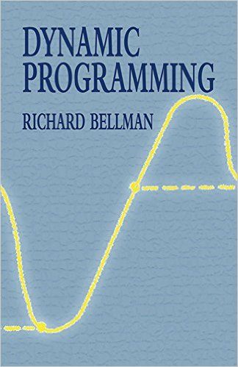
Is It Hopeless?
In theory, yes
In practice, no!
Dynamic programming to the rescue

Slide 13
Dynamic Programming?
Sometimes a name is just a name
“The 1950s were not good years for mathematical research… I felt I had to do something to shield Wilson and the Air Force from the fact that I was really doing mathematics... What title, what name, could I choose? ... It's impossible to use the word dynamic in a pejorative sense. Try thinking of some combination that will possibly give it a pejorative meaning. It's impossible. Thus, I thought dynamic programming was a good name. It was something not even a Congressman could object to. So I used it as an umbrella for my activities.
-- Richard Bellman

Slide 14
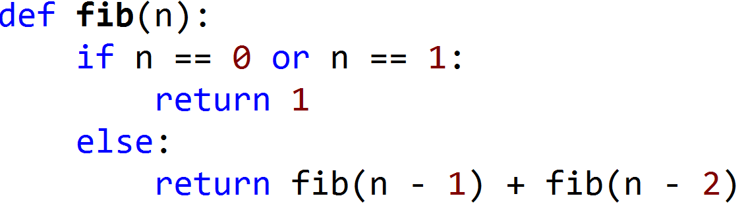
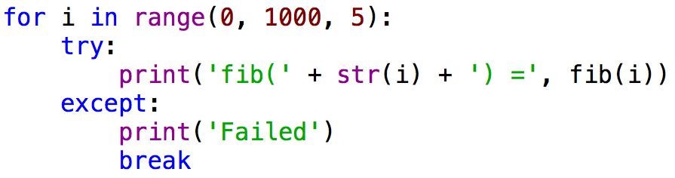
Returning to an Example from 6.0001
How far do think we’ll get before our patience runs out?
Why is it taking so long?

Slide 15
Call Tree for Recursive Fibonnaci(6) = 13
fib(6)
fib(4)
fib(3)
fib(2)
fib(3)
fib(2)
fib(2)
fib(1)
fib(1)
fib(0)
fib(1)
fib(0)
fib(1)
fib(1)
fib(0)
fib(5)
fib(4)
fib(3)
fib(2)
fib(1)
fib(0)
fib(2)
fib(1)
fib(1)
fib(0)

Slide 16
Clearly a Bad Idea to Repeat Work
Trade a time for space
Create a table to record what we’ve done
Before computing fib(x), check if value of fib(x) already stored in the table
If so, look it up
If not, compute it and then add it to table
Called memoization

Slide 17
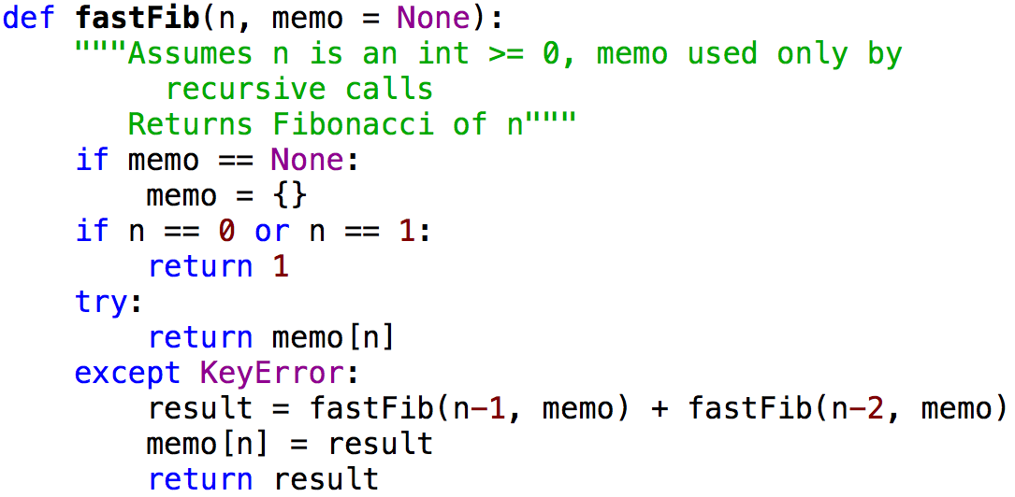
Using a Memo to Compute Fibonnaci

Slide 18
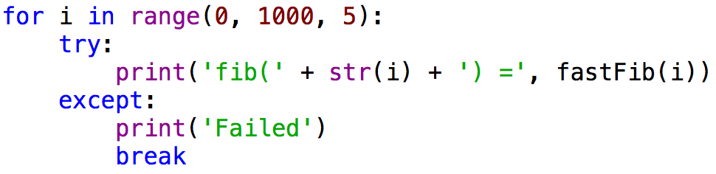
Let’s Try It
How far do think we’ll get before our patience runs out?

Slide 19
When Does DP Help?
Optimal substructure: a globally optimal solution can be found by combining optimal solutions to local subproblems
For x > 1, fib(x) = fib(x - 1) + fib(x – 2)
Overlapping subproblems: finding an optimal solution involves solving the same problem multiple times
Compute fib(x) or many times

Slide 20

What About 0/1 Knapsack Problem?
Do these conditions hold?

Slide 21
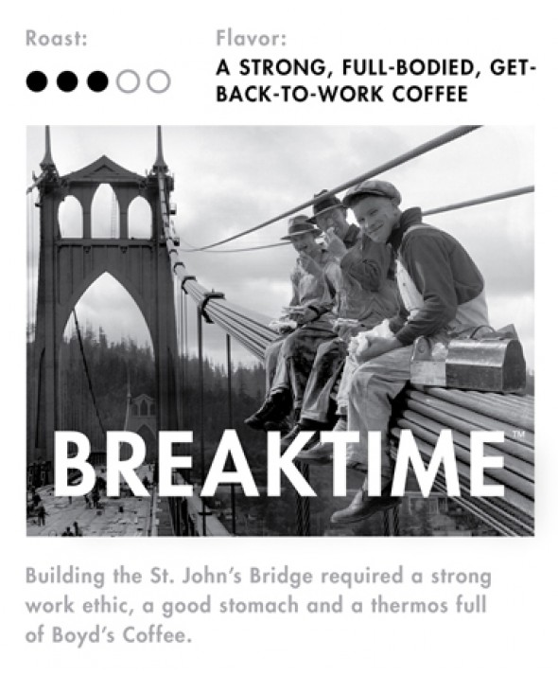
Five Minute Break

Slide 22
Does the Knapsack Problem Exhibit
Optimal substructure: a globally optimal solution can be found by combining optimal solutions to local subproblems
Overlapping subproblems: finding an optimal solution involves solving the same problem multiple times

Slide 23


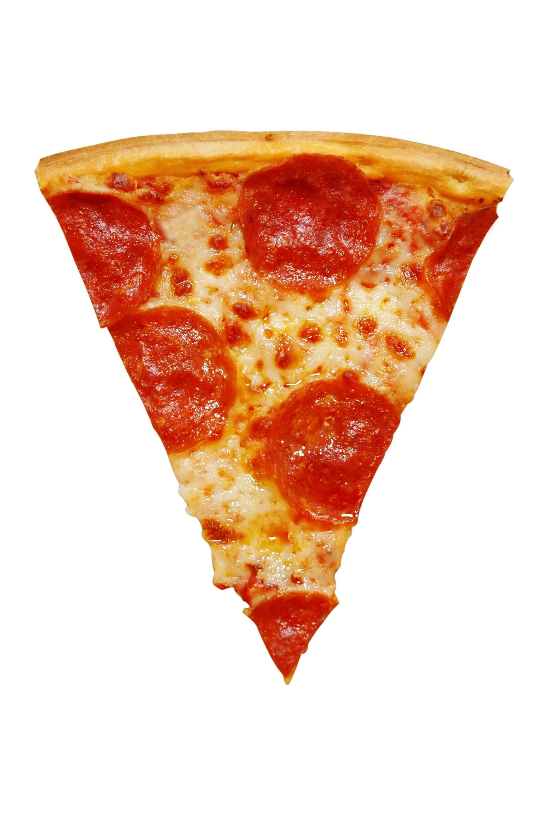
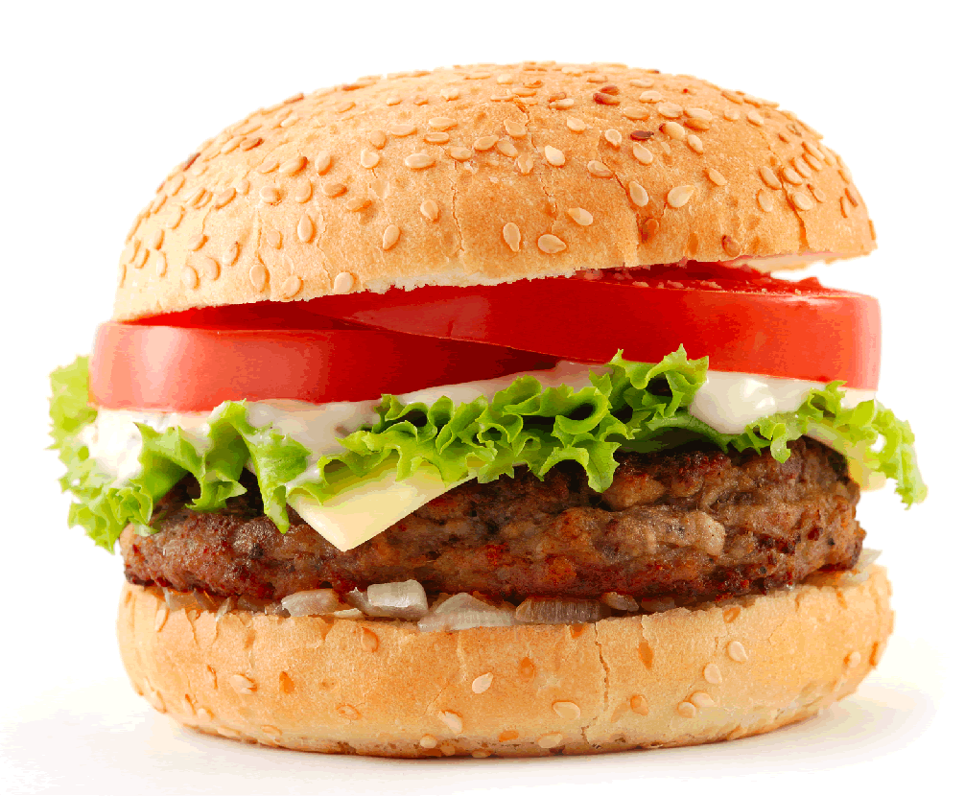
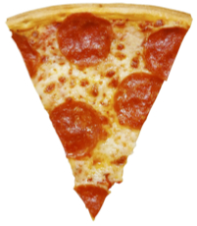
Search Tree
Optimal substructure?
Overlapping subproblems?
Take
Don’tTake
Val = 170
Cal = 766
Val = 120
Cal = 766
Val = 140
Cal = 508
Val = 90
Cal = 145
Val = 80
Cal = 612
Val = 30
Cal = 258
Val = 50
Cal = 354
Val = 0
Cal = 0

Slide 24
A Different Menu
Food | beer | pizza | burger | juice
Value | 90 | 30 | 50 | 85
calories | 154 | 258 | 354 | 154

Slide 25
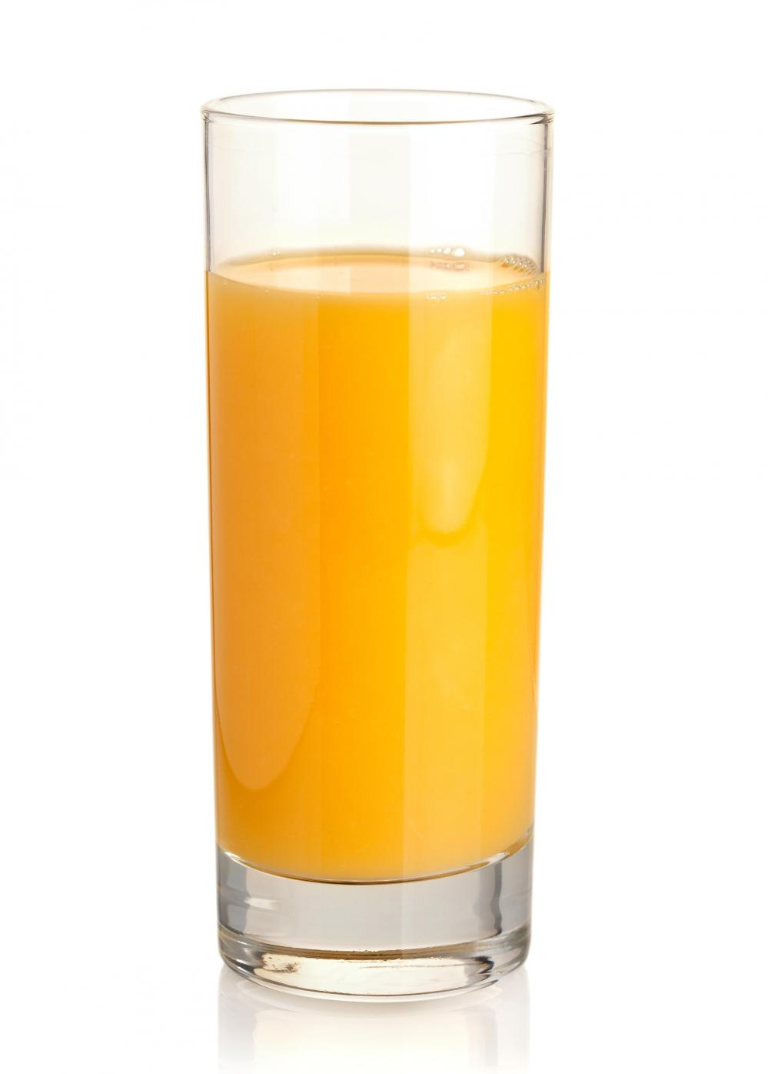
A Subtree
Take
Don’t Take

Slide 26
Problem Being Solved at Each Node
Given remaining weight, maximize value by choosing among remaining items
Set of previously chosen items, or even value of that set, doesn’t matter!

Slide 27
Modify maxVal to Use a Memo
Add memo as a third argument
Key of memo is a tuple
(items left to be considered, available weight)
Items left to be considered represented by len(toConsider)
First thing body of function does is check whether the optimal choice of items given the the available weight is already in the memo
Last thing body of function does is update the memo

Slide 28
Performance
len(items) | 2**len(items) | Number of calls
2 | 4 | 7
4 | 16 | 25
8 | 256 | 427
16 | 65,536 | 5,191
32 | 4,294,967,296 | 22,701

Slide 29
Performance
len(items) | 2**len(items) | Number of calls
2 | 4 | 7
4 | 16 | 25
8 | 256 | 427
16 | 65,536 | 5,191
32 | 4,294,967,296 | 22,701
64 | 18,446,744,073,709,551,616 | 42,569
128 | 340,282,366,920,938,463,463,374,607,431,768,211,456 | 83,319
256 | 115,792,089,237,316,195,423,570,985,008,687,907,853,269,984,665,640,564,039,457,584,007,913,129,639,936 | 176,614
Notes:
2**256 is about the number of atoms in the observable universe

Slide 30
Performance
len(items) | 2**len(items) | Number of calls
2 | 4 | 7
4 | 16 | 25
8 | 256 | 427
16 | 65,536 | 5,191
32 | 4,294,967,296 | 22,701
64 | 18,446,744,073,709,551,616 | 42,569
128 | 340,282,366,920,938,463,463,374,607,431,768,211,456 | 83,319
256 | 115,792,089,237,316,195,423,570,985,008,687,907,853,269,984,665,640,564,039,457,584,007,913,129,639,936 | 176,614
512 | Really really big number | 351,230
1024 | Absolutely huge | 703,802
Notes:
2**256 is about the number of atoms in the observable universe

Slide 31

How Can This Be?
Problem is exponential
Have we overturned the laws of the universe?
Is dynamic programming a miracle?

Slide 32
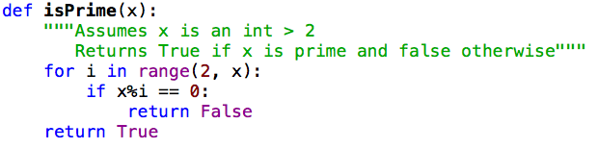
A Miracle?
No, but computational complexity can be subtle
Algorithm falls into a complexity class called pseudo-polynomial
And for some range of values, we don’t care about number of bits
Linear in value of x
But exponential in number bits used to represent x, i.e. in length of input—2^{log(x)}

Slide 33
And fastMaxVal?
Running time of fastMaxVal is polynomial in number of distinct pairs, <toConsider, avail>
Number of possible values of toConsider bounded by len(items)
Possible values of avail a bit harder to characterize
Bounded by number of distinct sums of weights

Slide 34
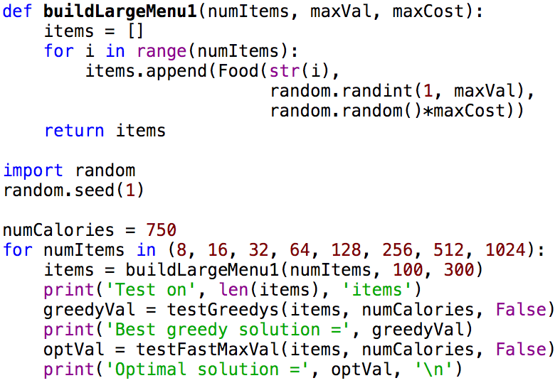
More Distinct Combinations

Slide 35
Summary of Lectures 1-2 (so far)
Many problems of practical importance can be formulated as optimization problems
Greedy algorithms often provide adequate (though not necessarily optimal) solutions
Finding an optimal solution is usually exponentially hard
But dynamic programming often yields good performance for a subclass of optimization problems—those with optimal substructure and overlapping subproblems
Solution always correct
Fast under the right circumstances

Slide 36
Since I Have a Few Minutes, more Python
Conditional expressions
List comprehension

Slide 37
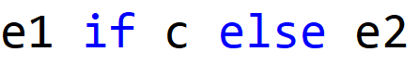
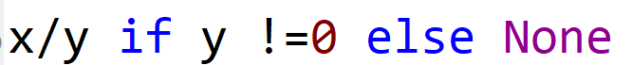
Conditional Expressions
Evaluate c
If c is True, the value of the expression is e1
If c if False, the value of the expression is e2

Slide 38
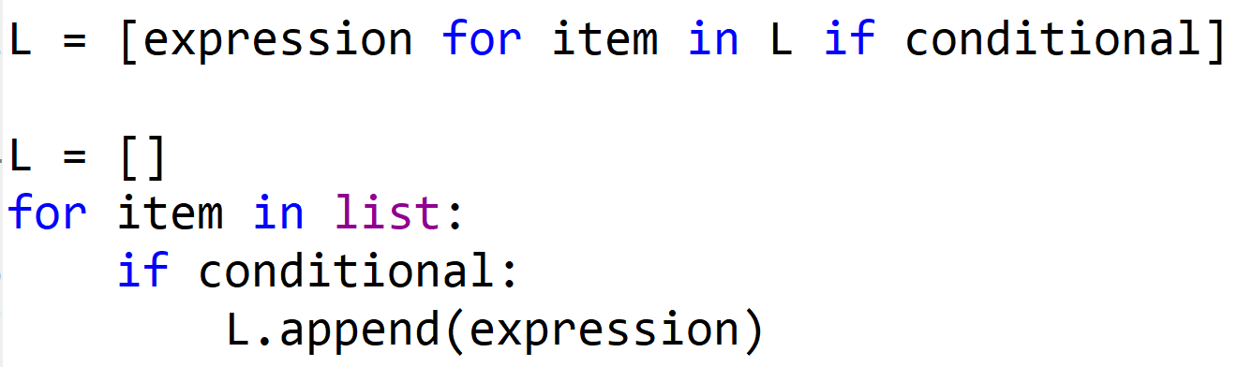
List Comprehension

Slide 39
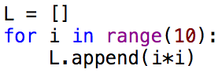
List Comprehension

Slide 40
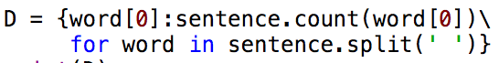
List Comprehension

Slide 41
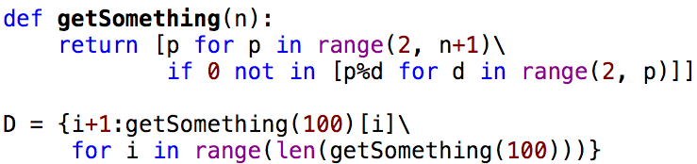
Today’s Puzzler

